Slide 1
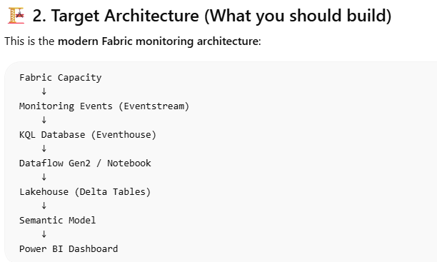
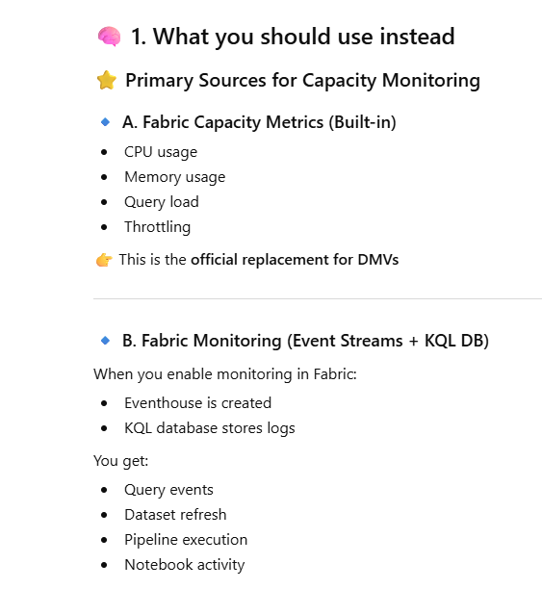
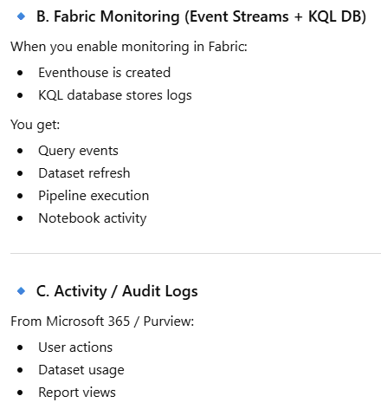
Fabric platform monitoring

Slide 2
Fabric platform monitoring
Capacity Metrics app
Fabric Eventhouse Monitoring
Fabric United Admin Monitoring(FUAM) setup p12-13

Slide 3
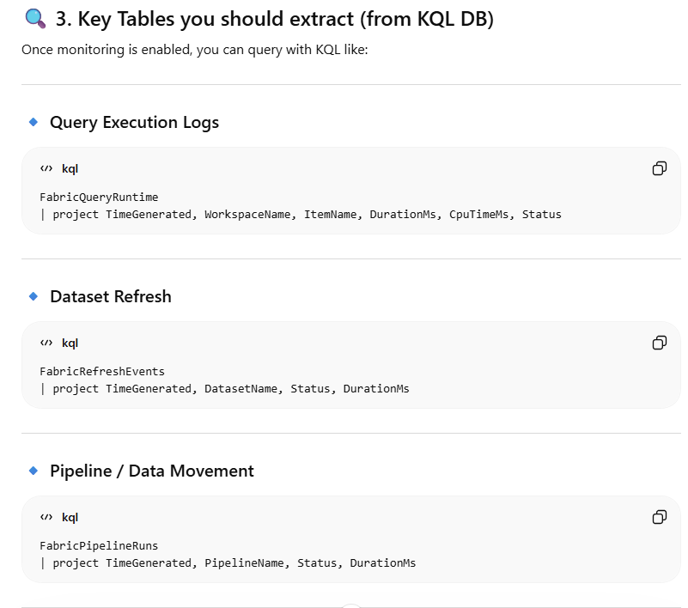
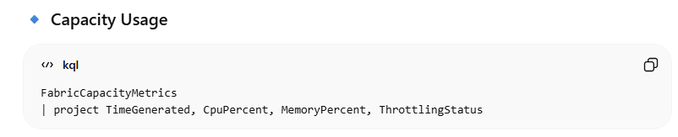
Fabric platform monitoring / table to extract from KQL

Slide 4
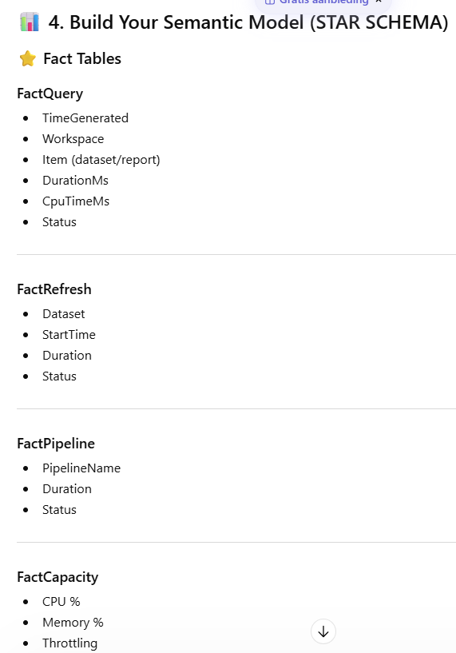
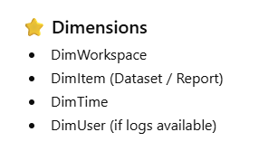
Fabric platform monitoring / file table fact and Dim

Slide 5
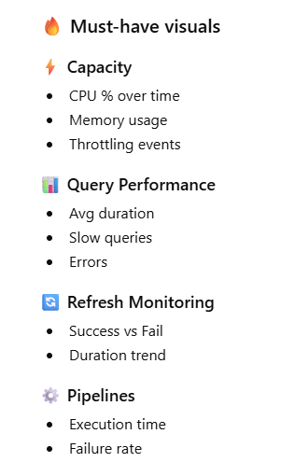
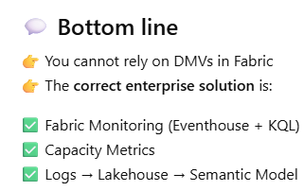
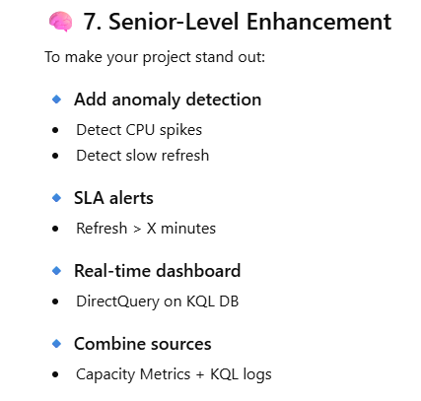
Fabric platform monitoring /necessary visuals

Slide 6
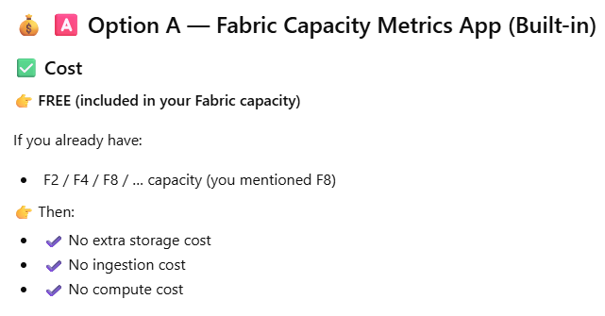
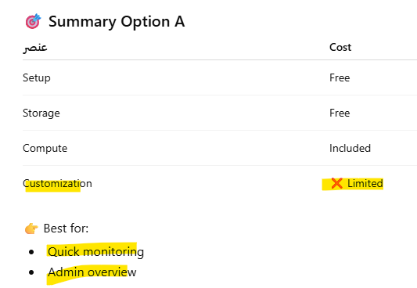
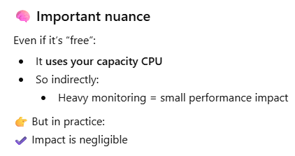
Fabric platform monitoring /Cost consideration

Slide 7
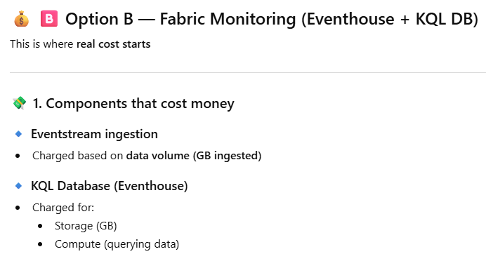
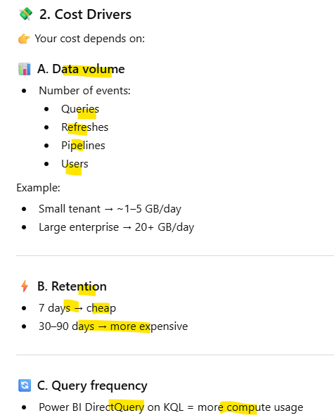
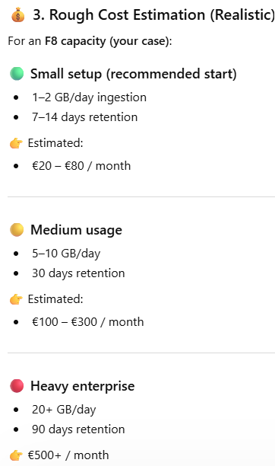
Fabric platform monitoring /Cost consideration

Slide 8
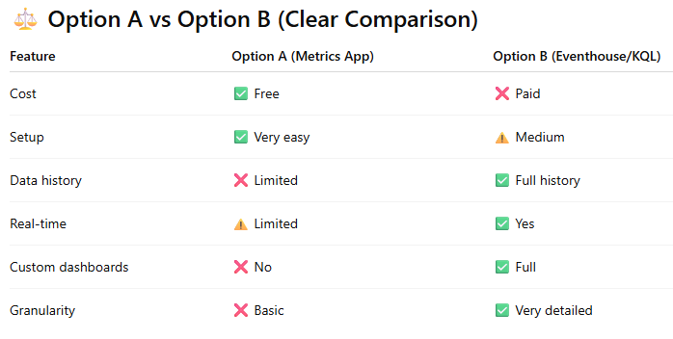
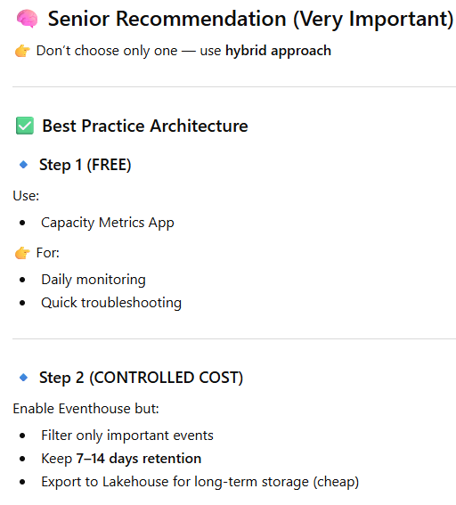
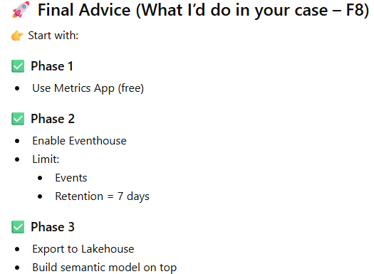
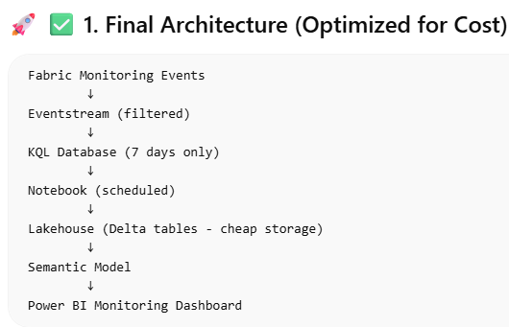
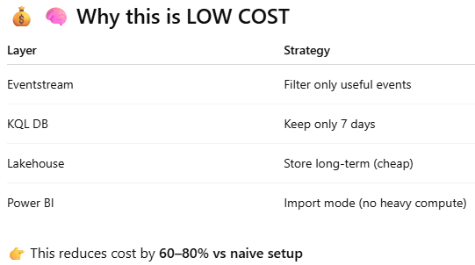
Fabric monitoring /Cost comparison en conclusion

Slide 9
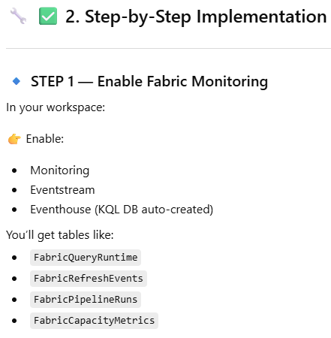
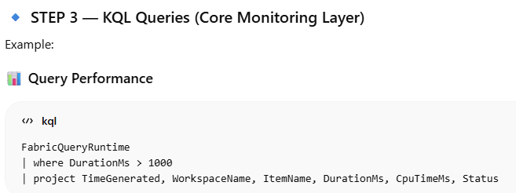
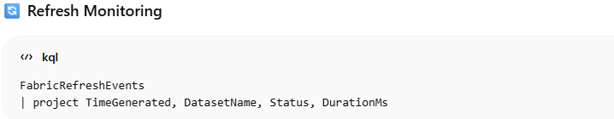
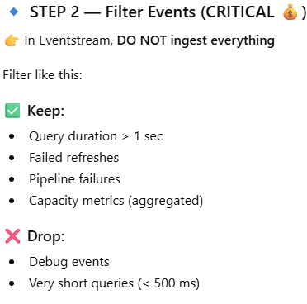
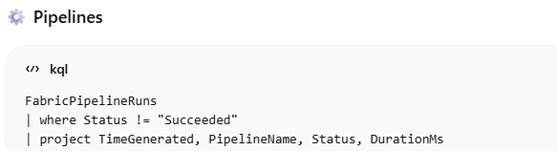
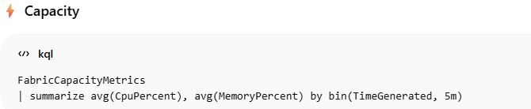
Fabric monitoring /Implementation /KQL

Slide 10
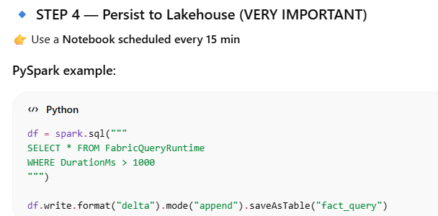
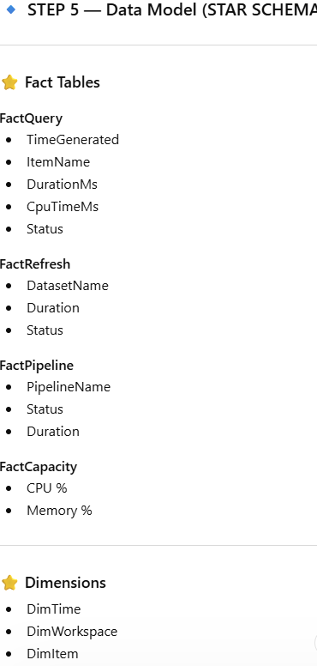

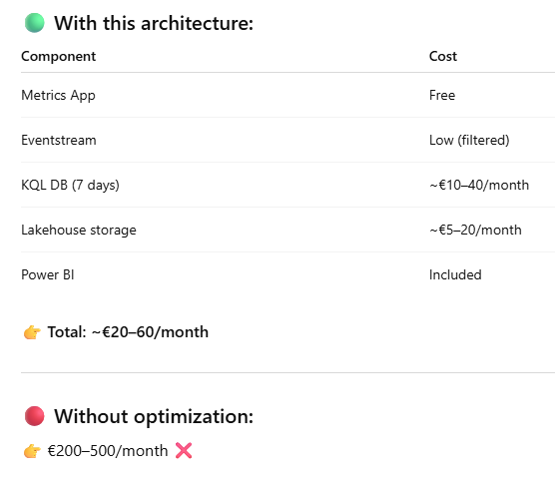
Fabric monitoring /Implementation /Lakehouse

Slide 11
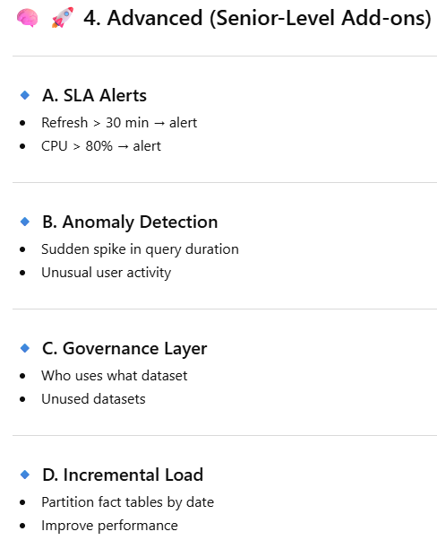
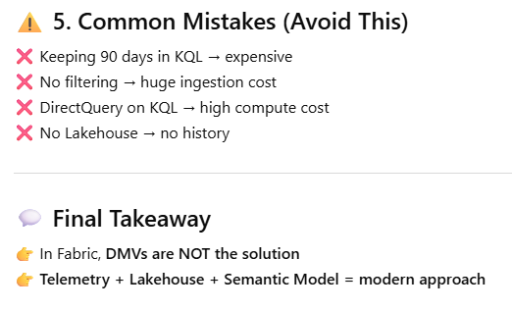
Fabric monitoring /Implementation Recommandation

Slide 12
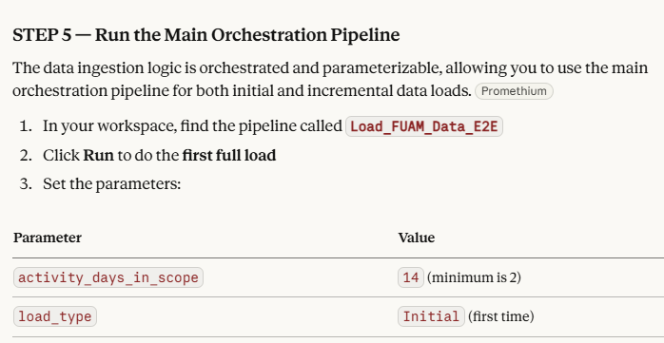
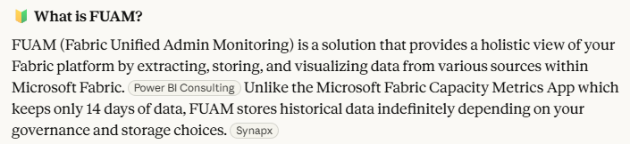
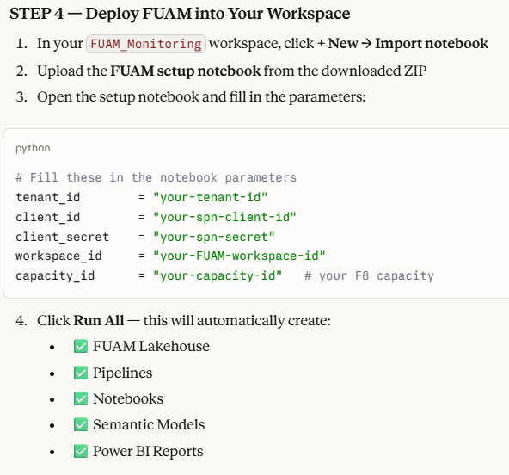
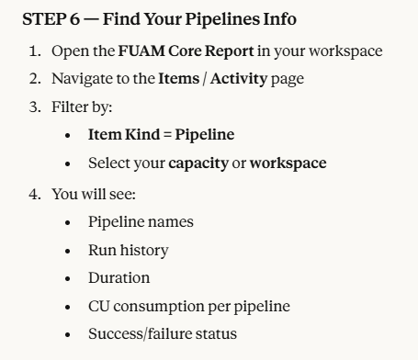
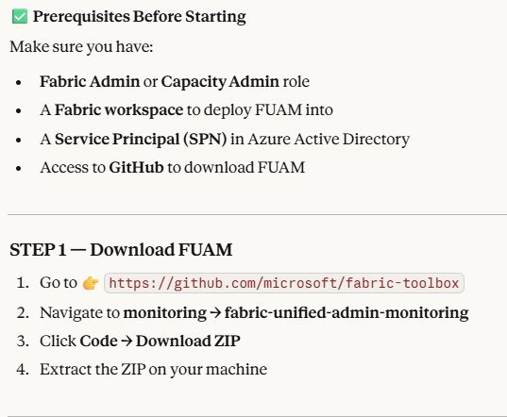
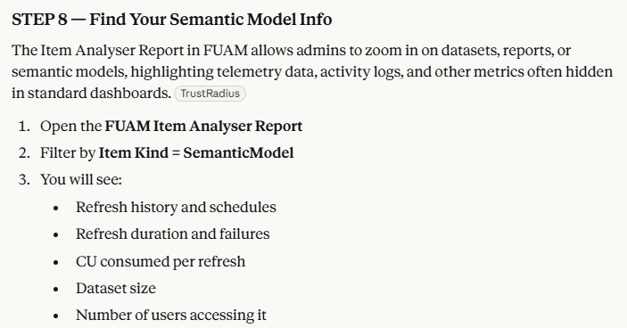
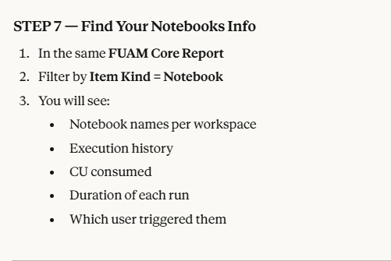
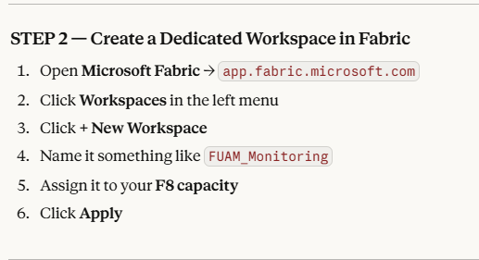
FUAM

Slide 13
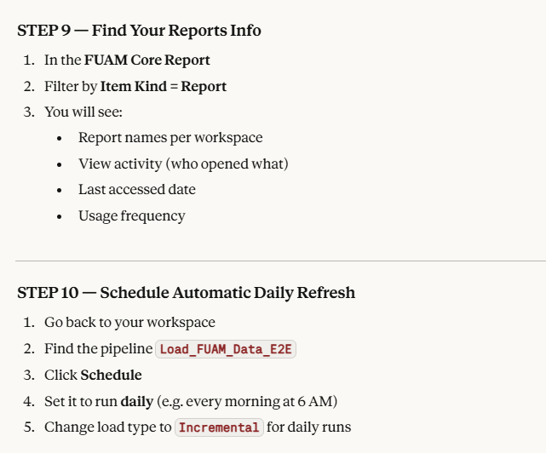
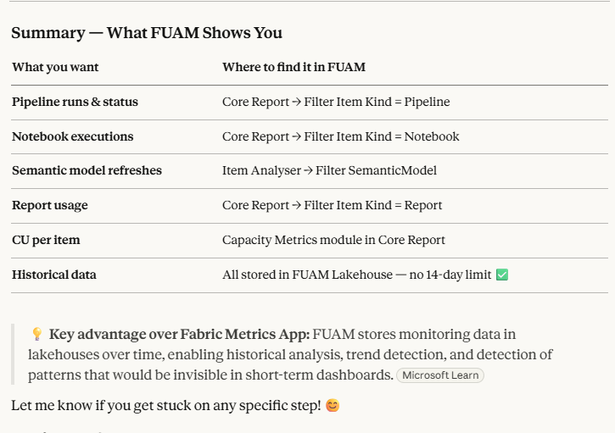
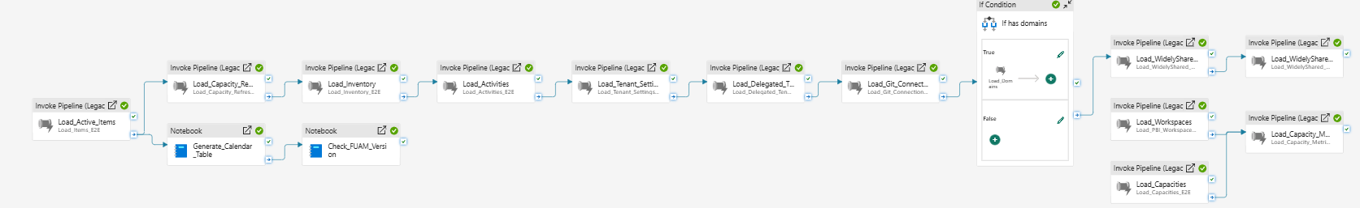
FUAM
FUAM master pepeline in action and run succesfully

Slide 14
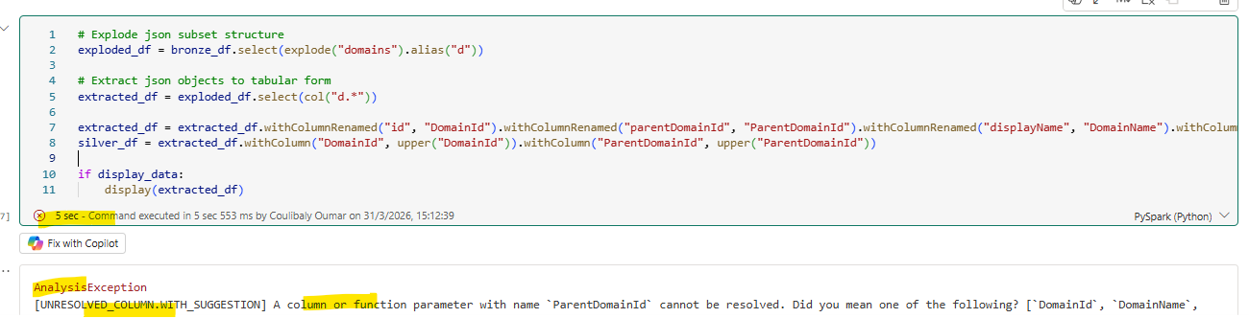
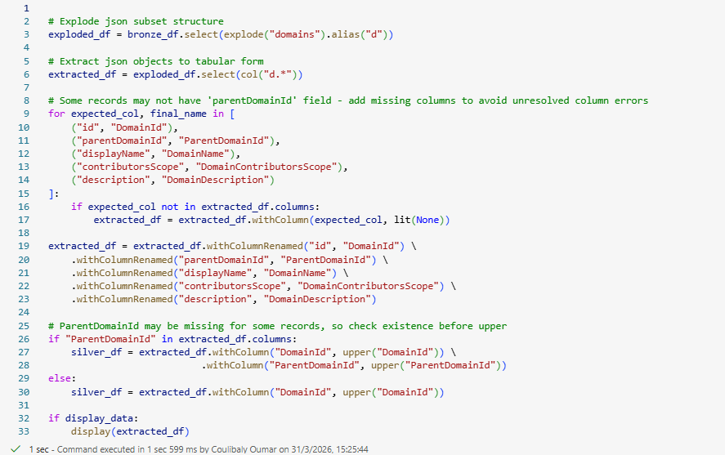
Some Notebooks erros (domain pipeline)
error
# Explode json subset structure
exploded_df = bronze_df.select(explode("domains").alias("d"))
# Extract json objects to tabular form
extracted_df = exploded_df.select(col("d.*"))
extracted_df = extracted_df.withColumnRenamed("id", "DomainId").withColumnRenamed("parentDomainId", "ParentDomainId").withColumnRenamed("displayName", "DomainName").withColumnRenamed("contributorsScope", "DomainContributorsScope").withColumnRenamed("description", "DomainDescription")
silver_df = extracted_df.withColumn("DomainId", upper("DomainId")).withColumn("ParentDomainId", upper("ParentDomainId"))
if display_data:
display(extracted_df)
Original code
Fix from copilot

Slide 15
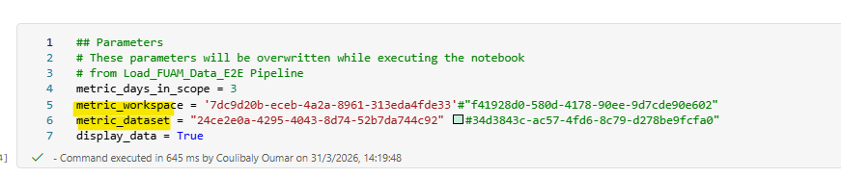
Some pipeline capacity metrics error
The automaticlly created pipeline made some mistable on the Capacity metrcis Workspace info,
Capacity metric WS ID and and datatest ID were wrong in the Master pipeline , make sure you add the good values

Slide 16
Some pip capacity metrics
The automaticlly created pipeline made some mistable on the Capacity metrcis Workspace info,
Capacity metric WS ID and and datatest ID were wrong in the Master pipeline , make sure you add the good values

Slide 17
Some Service principale errors for erchestration
Using the service prinpal created to connect to Faric website. We are getting still some errors saying the caller in not authenticated.
Workarround : User your own account (if you a Fabric Capacity and Capacity metric Admin and

